Slide 1



Introduction to Image Classification
Image classification is the task of identifying and labeling the contents of digital images. It has wide-ranging applications from medical diagnosis to autonomous vehicles, and is a fundamental problem in computer vision.
by Adal Rasheed

Slide 2
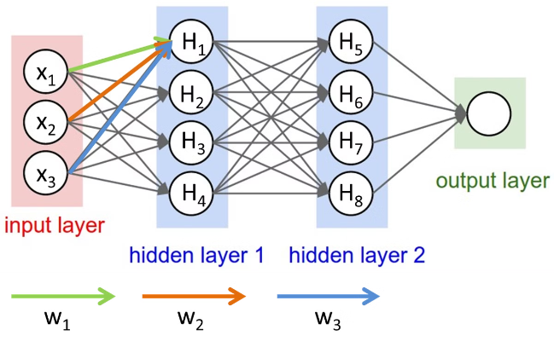
Overview of Convolutional Neural Networks (CNNs)
1
Convolutions
Applying filters to extract local features from images.
2
Pooling
Downsampling feature maps to reduce dimensionality.
3
Dense Layers
Fully connected layers to classify the extracted features.

Slide 3
CNN Architecture and Key Components
Input Layer
Convolutional Layers
Pooling Layers
Accepts the input image.
Apply learned filters to extract visual features.
Reduce the spatial size of feature maps.

Slide 4

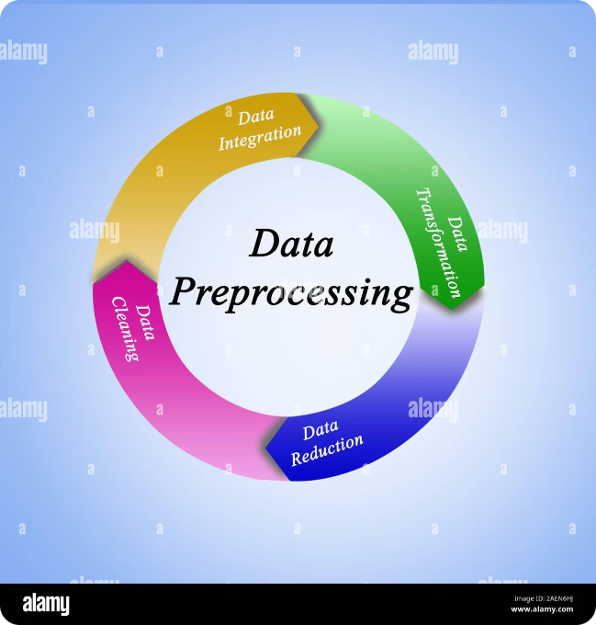
Preparing Image Data for Training
1
Data Augmentation
2
Normalization
Artificially expand the training dataset through transformations.
Ensure input images have a common scale and distribution.
3
Train-Validation-Test Split
Partition data for training, validation, and final testing.

Slide 5

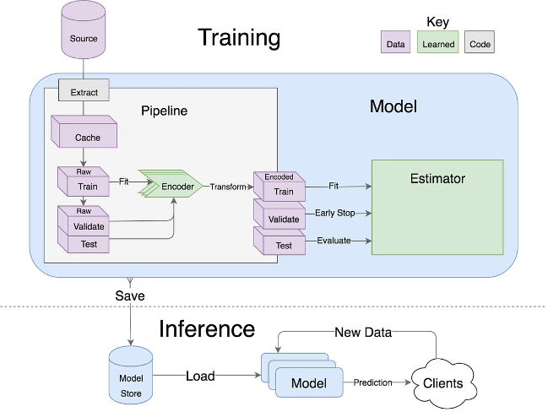
Designing the CNN Model
Hyperparameters
Transfer Learning
Select model architecture, learning rate, batch size, etc.
Leverage pre-trained models to speed up training.
Regularization
Optimization
Prevent overfitting through techniques like dropout.
Choose an appropriate optimizer for efficient training.

Slide 6


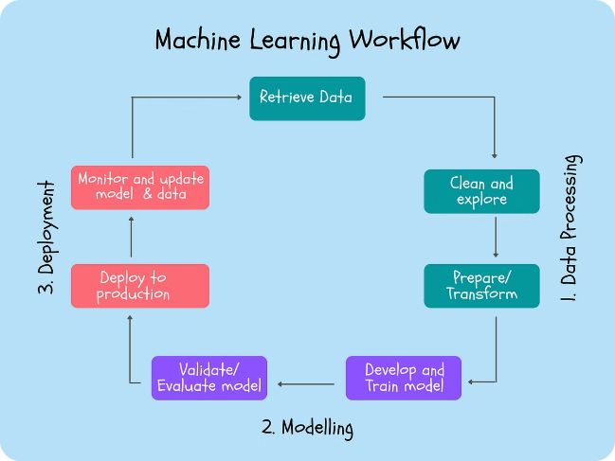


Training the CNN Model
Forward Pass
Input image through the network to get predictions.
Backpropagation
Compute gradients and update model parameters.
Epoch Iterations
Repeat the forward and backward passes for all training data.

Slide 7


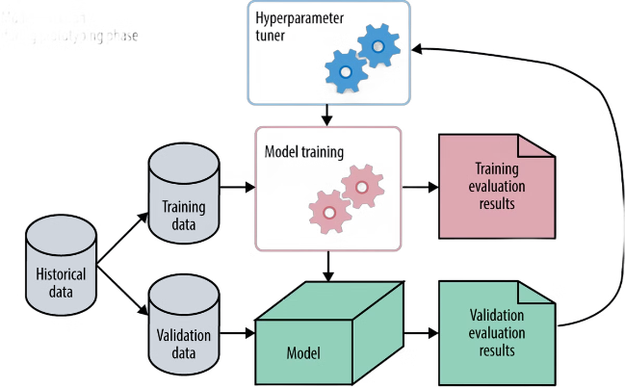


Evaluating Model Performance
Accuracy
Precision
Percentage of correct predictions.
Fraction of true positives among all positive predictions.
Recall
F1-Score
Fraction of true positives among all actual positives.
Harmonic mean of precision and recall.

Slide 8
Improving Model Accuracy
Collect More Data
Tune Hyperparameters
Feature Engineering
Expand the training dataset for better generalization.
Experiment with model architecture and training settings.
Enhance the input data to help the model learn better.

Slide 9
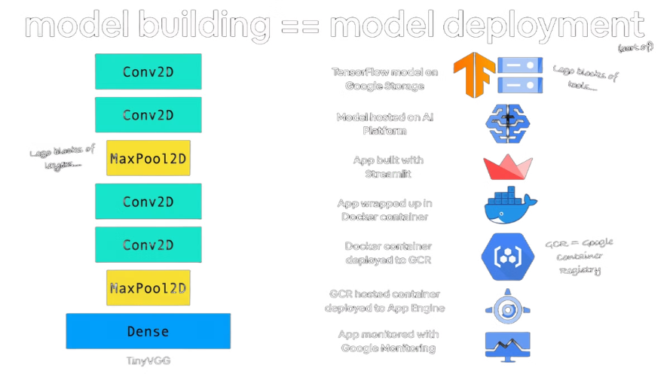
Deploying the Image Classifier
Cloud Hosting
Deploy the model on cloud platforms like AWS, Azure, or GCP.
On-Device Inference
Run the model directly on mobile or edge devices.
API Integration
Expose the model through a RESTful API for easy integration.

Slide 10

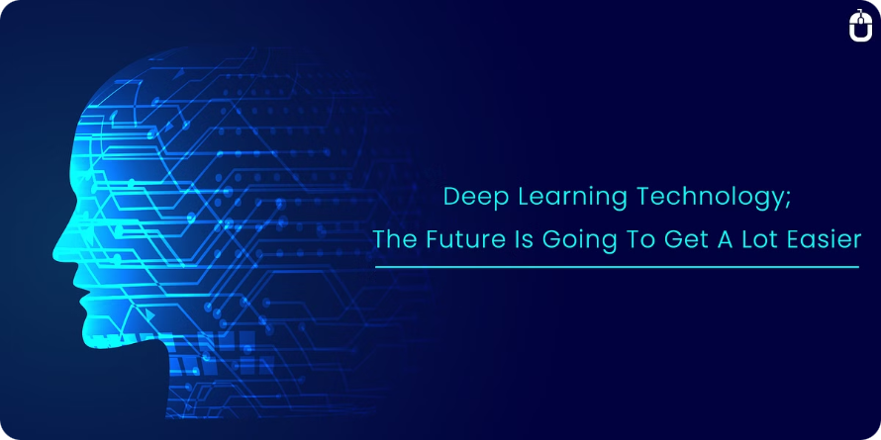
Conclusion and Future Considerations
1
Continual Learning
Enabling models to adapt and learn over time.
2
Explainable AI
Making deep learning models more interpretable.
3
Adversarial Robustness
Improving model resilience to malicious inputs.
Thank you!
Notes:
• Continual learning is an important area of focus - enabling our models to adapt and learn over time, rather than being static. • Explainable AI is crucial for building trust in deep learning systems. We need to make these complex models more interpretable and understandable. • Adversarial robustness is key to ensuring our models are resilient to malicious inputs or attempts to fool the system. This is an area that requires ongoing research and development. • These three focus areas - continual learning, explainable AI, and adversarial robustness - represent important frontiers in deep learning that we must continue to push forward. They will be critical to realizing the full potential of this transformative technology.

